Slide 1

Virtual AI Career Advisor Project-I
BACHELOR OF TECHNOLOGY
(Computer Science and Engineering.
SUBMITTED BY:
Team Member 1 - Nikhil Kumar (2230813)
Team Member 2 - Gaurav Sharma (2230771)
Team Member 3 - Jitesh Jaswal(2230784)
Team Member 4 - Konal Sharma(2230789)
Under the Guidance of
Ms. Jaspreet Kaur
Assistant Professor(CSE)
Department of Computer Science & Engineering
Chandigarh Engineering College Jhanjeri
Mohali - 140307

Slide 2
Introduction
The Virtual AI Career Advisor is a platform designed to provide intelligent career recommendations based on users' skills, interests, and experience. It integrates with advanced AI APIs like Groq for real-time, personalized feedback.

Slide 3
Objective
To develop an AI-powered system that helps students and professionals choose a suitable career path, analyze resumes, track market trends, and improve decision-making through interactive chat assistance.

Slide 4
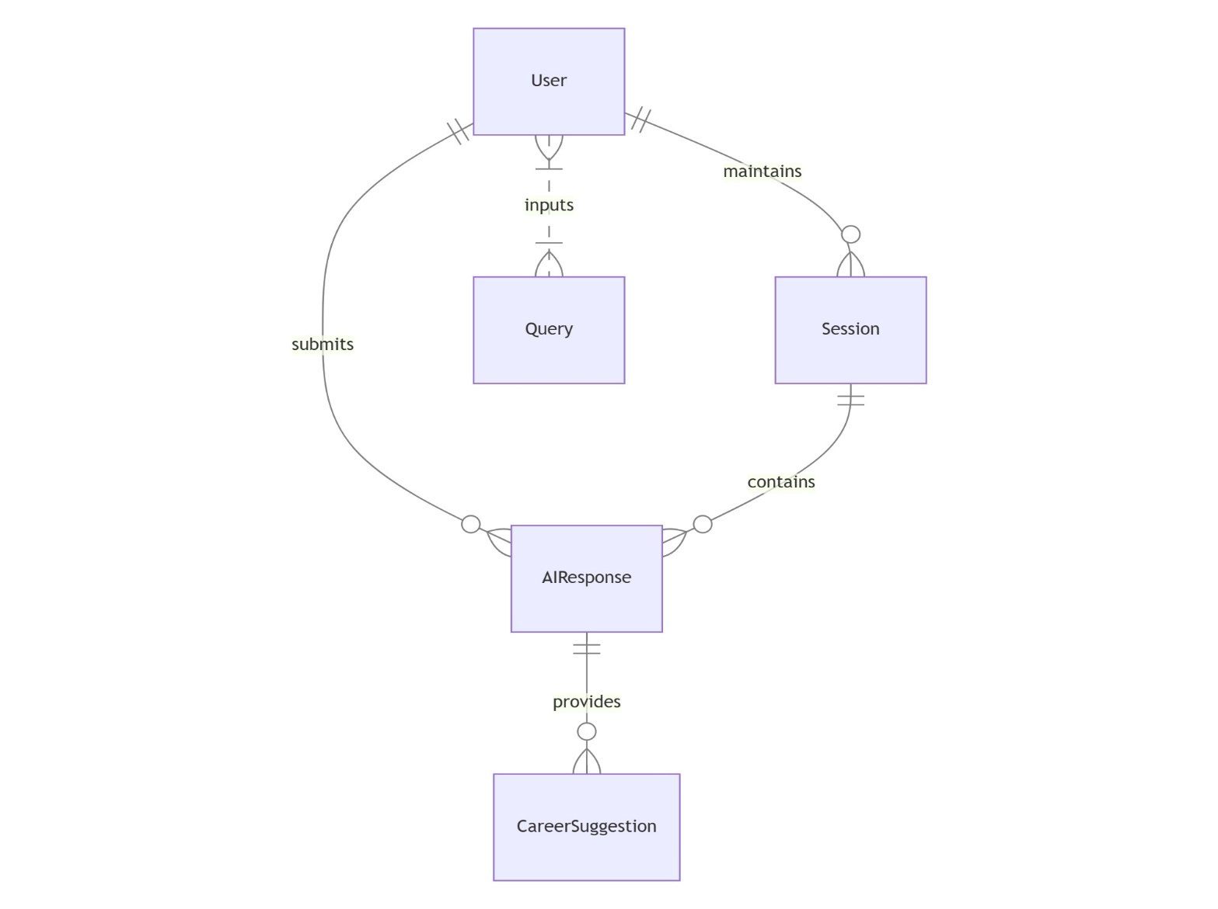
System Architecture
ER Diagram.
Groq API -> Career Recommendation Output

Slide 5
Technologies Used
Frontend: ReactJS
Backend: FastAPI
AI API: Groq API
Language: Python
Deployment: Localhost / Future Cloud Integration

Slide 6
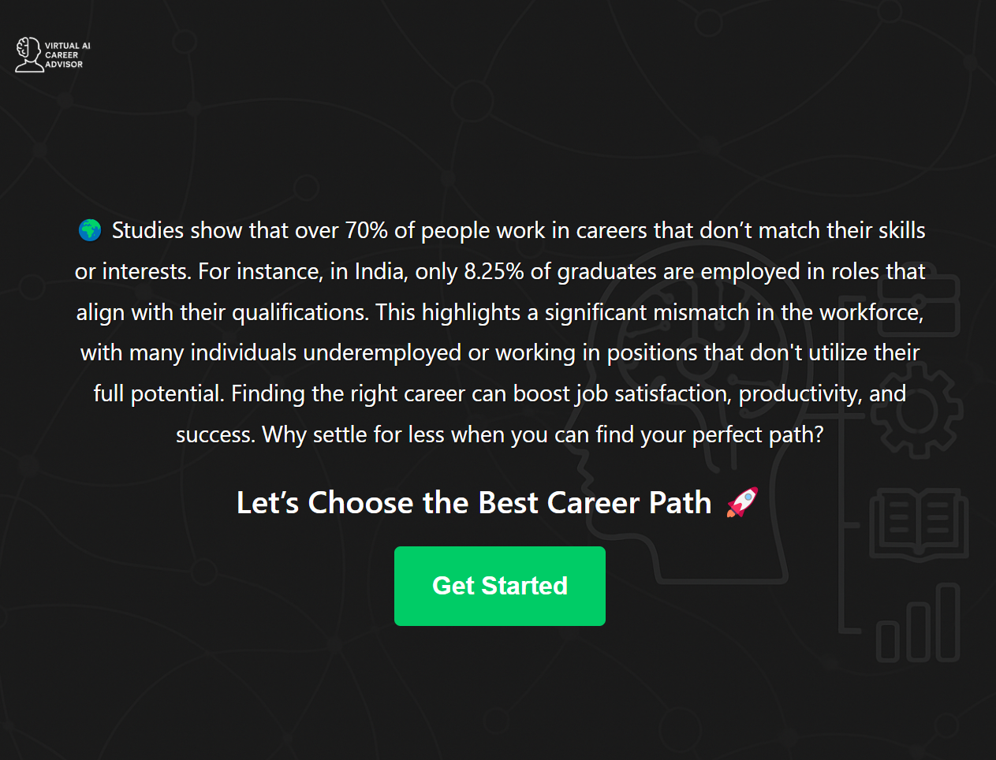
Modules
1. Career Recommendation
2. Resume & Skill Analysis
3. Job Market Trends
4. Interactive Chatbot

Slide 7
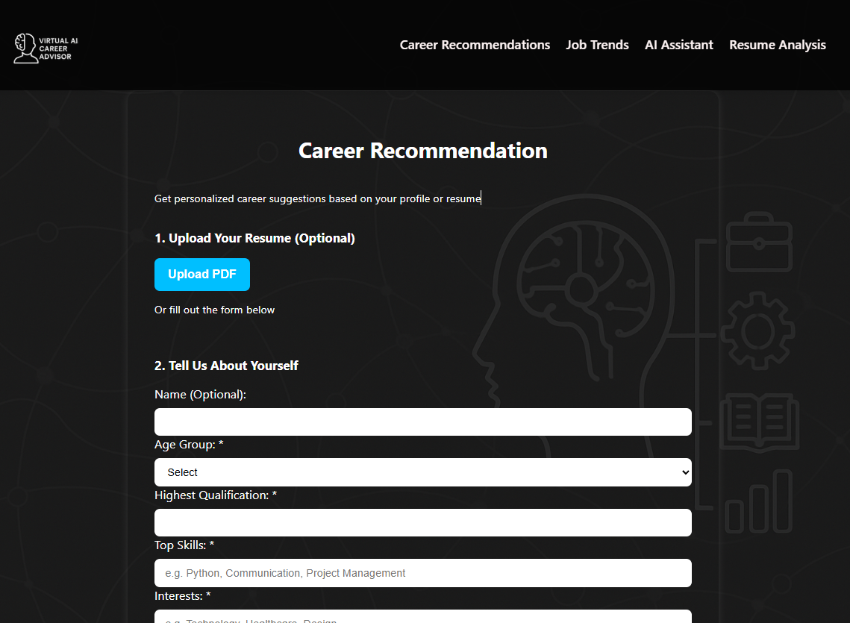
Career Recommendation
User either upload a resume or inputs qualification, skills, interests, work style, etc.
FastAPI backend formats the data into prompts
Groq API returns suitable career paths with reasoning

Slide 8
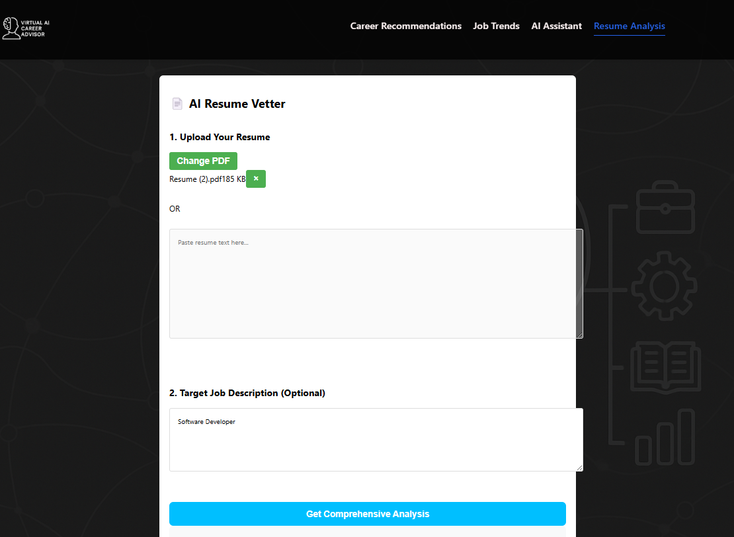
Resume Analysis
User can upload the resume pdf or text and give the job description for specified job for which the resume is built.
Skills are extracted and evaluated
The resume is vetted and scored.
Recommendations are given to improve the resume

Slide 9
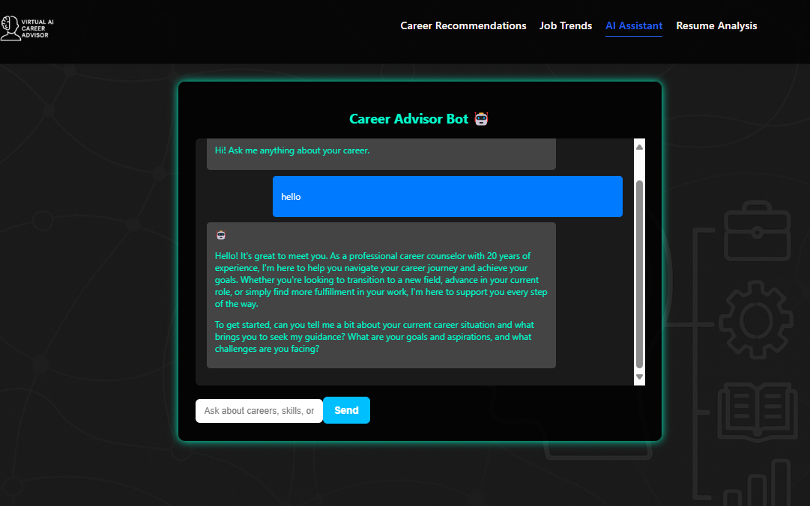
Chatbot Functionality
Interactive Q&A powered by Groq API
Offers tips, guidance, and motivation
Responds contextually based on career questions

Slide 10
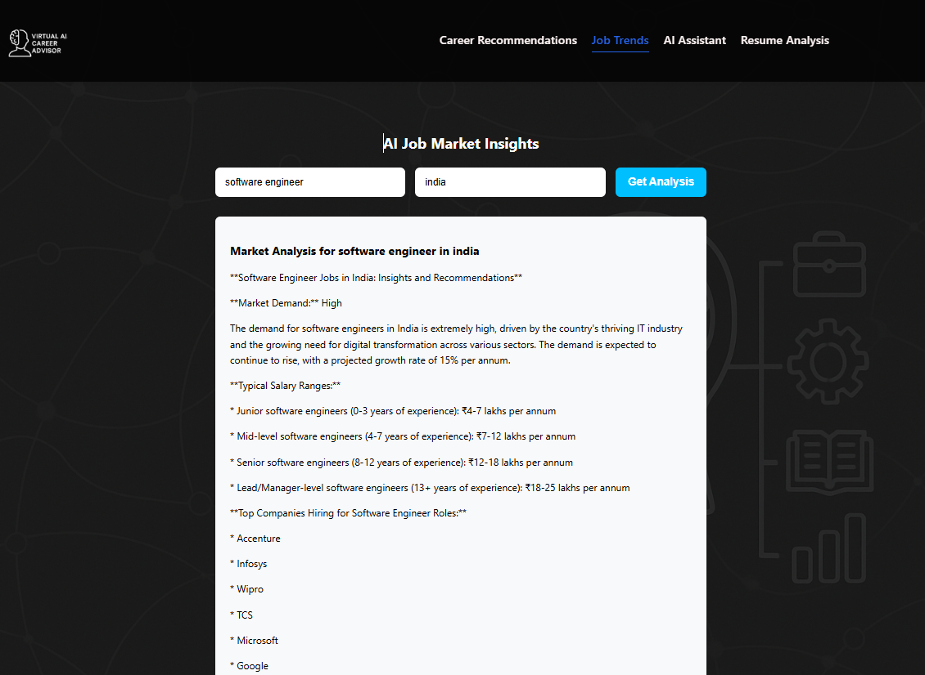
Job Market Trends
Analyzes current job market demand using external APIs
Displays trending roles, industries, and required skills
Prepares users for future career changes

Slide 11
Conclusion
The Virtual AI Career Advisor is a step toward democratizing career guidance through artificial intelligence. With Groq’s processing capabilities, it delivers rapid and relevant insights.

Slide 12
Future Scope
Add PDF resume parsing
Integrate real-time job APIs (e.g. Adzuna)
Build admin dashboard
Deploy to cloud with authentication

Slide 13
Thankyou

